Slide 1
Clark Snelgrove BA (Physics Education), MS (Physics Teaching), ABD (Curriculum and Instruction) Brigham Young University, Provo, Utah AAPT Summer Meeting 2016 Sacramento, CA
Developing a laboratory course for the life science majors at BYU

Slide 3
A “Train Wreak” was inevitable
Old lab program was >20 years old. Nobody in the department could really remember when it was written.
The lab equipment was long overdue for replacement.
The attitude of the faculty was that it “worked well enough” so it didn’t really need anything more then some “minor” changes. When in reality most days the program was near collapse because the old equipment and the activities didn’t really “work”.
Most of the faculty that had “taught” the program in recent years had simply published the lab manual and then let the teaching assistants (TAs) run things the way that they wanted to.

Slide 4
A “Train Wreak” was inevitable
The TAs had developed a “tribal” knowledge of how to survive the teaching assignment that they passed on to each other.
The TAs received very little training on how to teach and run the program.
To the TA’s credit they were able to do this for many years because we have incredible students at BYU with phenomenal backgrounds. Many of our TAs have served as missionaries for our church and have a great deal of teaching experience already.
The students had developed a network of communicating with their peers about how miserable the course was and a set of “tricks” that could be used to survive the course.

Slide 5
To Save the Train it would take a “Superman”
The hero has >20 year of educational experience
The hero has taught for 16 years introductory physics in the public school
The hero worked for four years full time at Virginia Tech developing physics laboratory infrastructure and curriculum.
The hero had spend two years working on a PhD in curriculum and instruction at Virginia Tech.

Slide 6
Alas not even “Superman” can prevent all disasters
My “day” job was managing the Demonstration program for the department.
I was supposed to have 25% of my time to commit to “other” departmental needs. This project was more than a full time job for several people for several years.
The management of the course and the development were each big jobs. There are more than 400 students enrolled in the first semester course alone.
Sometimes it is better to have the train wreak, clean up the mess and start over again.

Slide 7
Start with a “Plan”
I spent over one year preparing to make the changes.
I researched who the students were that take the class.
I talked with the faculty from the departments that the students major in for input.
I researched the parts of the program that seemed to be working.
I attended the TA meeting weekly for over a year learning how the TAs ran the class.
I asked the physics faculty about how they ran the course in the past.

Slide 8
Proposal For Physics 107 & 108 Laboratory Reform

Slide 9
AAPT Guidelines
Constructing knowledge
Modeling
Designing Experiments
Laboratory skill
Analyzing and visualizing data
Communicating Physics

Slide 10
A New Pedagogical Style
Old labs were:
Traditional verification of a physical law.
Get the “right” answer
Fill in the blanks on a report form
Very limited focus on conceptual learning
Many activities were like book problems.
New labs:
Guided Inquiry learning cycle
Predict
Observe
Explain
Repeat
Learning more based on learning physics concepts from laboratory experiences

Slide 11
Primary goals of the activities
Develop physical concepts (physical intuition)
Help students develop a sense of how the physics that they are learning can help them in their future lives
Obtain physically meaningful data using appropriate laboratory skills and represent it in multiple formats
Evaluate the quality of their experimental data
Use their experimental data to construct ‘models’ of the physical concepts. Avoid the ‘verification’ model of older style labs.

Slide 12
Secondary Goals of the Activities
Extend their understanding of what they learned by designing an extension lab activity
Write a short research paper on their extension activity using appropriate external references and their experimental data
Communicate to their class the results of their extension activities

Slide 13
Redefining the Schedule
Currently the first week of classes is unused
Previous scheduling methods limited the number of weeks that could be used
New scheduling of the lab activities will allow for thirteen weeks of lab activities
It is proposed the we have twelve formal lab activities with the thirteenth week used to present extension activities.

Slide 14
Procedural Changes
Better training for teaching assistants
Shift the role of the teaching assistants toward being better mentors
Improve the management of the laboratory equipment to help the teaching assistant spend less time with equipment troubleshooting
Shift the grading procedure to minimize the tedium of ‘just producing scores’

Slide 15
Grading Procedures
Grading based on multiple measurement tools
Computer scored Pre-lab and Post-lab Quizzes
Extension projects and presentation
Notebook checks
Participation scores
Lab team collaboration activity scores
Peer evaluation of other students’ work
Teaching assistant’s grading time is to be refocused on giving feedback to students

Slide 16
Content Topics: Physics 107
Lab 1: Video Analysis of the Motion
Lab 2: Studying Falling Objects
Lab 3: Studying objects in two dimensions
Lab 4: Forces on objects in linear systems
Lab 5: Analysis of Extended Bodies
Lab 6: Forces and Torque
Lab 7: Energy and Power
Lab 8: Analysis of Exercise Equipment
Lab 9: Studying Air Flow and Air Drag
Lab 10: Liquid flow in a Circuit
Lab 11: Calorimetry and Thermal Properties of Matter
Lab 12: Oscillations, waves, and sound

Slide 17
Content Topics: Physics 108
Lab 1: Electrostatic Experiments
Lab 2: Electric Potential
Lab 3: DC Circuits I
Lab 4: DC Circuits II
Lab 5: Magnetism I
Lab 6: Magnetism II
Lab 7: Ray Optics, Optical Lenses and Mirrors
Lab 8: Optical Principles of the Eye
Lab 9: Wave Nature of Light
Lab 10: Atomic Spectra: Spectroscope
Lab 11: Quantum effects
Lab 12: Radioactivity

Slide 18
What went wrong with the plan? It was too much to attempt in one pass.
I was assigned to manage the logistics of the course of over 400 students in 19 sections being taught by 12 teaching assistants.
New equipment was being purchase and delivered throughout the semester
I had to write each of the new activities in the guided inquiry format as well as quizzes, grading rubrics, etc.
I had been told not to do too much changing all at once.
The pedagogical style change required all labs to be at least rewritten for format.
Some old activities did actually work so they needed to be replaced new activities. This required extensive testing.

Slide 19
Things that were improved!!
All of the lab activities actually work now.
Pre-lab and Post-lab quizzes were put online so that TAs to improve the use of TA time.
Post-Lab quizzes were based on “real” lab data with an attempt to detect if the students had really learned something.
Student summaries were submitted online for TA grading and Peer Review grading.
TA grading load was shifted toward giving feedback verses just giving a score for filling the lab notes.
TA training was improved.

Slide 20
More things that were improved!!
Improvements in the laboratory equipment and it reliability
Built grading rubrics so the students knew what they were being graded on.
Use “Peer Review” to teach students how to write better laboratory summaries.
Use of actual student data from the lab experiments to create quiz questions.
Quiz questions tested concepts, interpretation of data, and error analysis.

Slide 21
One goal was to have the labs be “authentic” to life science.
I am still not sure what that means yet.
The physics faculty are not really ready to leave a traditional topical model of teaching introductory physics.
The students didn’t really seem to care if the activities are “authentic”. They were quite satisfied with just having a traditional physics course that will check the box them for the MCAT or some other post baccalaureate programs.
So for now we will set aside this lofty goal in favor of a program that “works”.

Slide 22
The activity that I thought would seem the least “authentic” was the projectile motion lab.
A new projectile launcher makes all the difference.
The liked that the data was very repeatable.
The liked being able to predict with precision the trajectory of the ball.
The liked the challenge of having to get the ball to travel through a hoop in the middle of the trajectory.

Slide 23
An example of an activity that didn’t work The old Fluid Flow apparatus
Fill a beaker with water from the jug while measuring the time to fill.
Compare the flow rate out of the jug with Torricelli’s law for the depth of the water in the jug.
The results were so poor that the TAs literally told the students what numbers to enter into their lab reports to get a passing grade.

Slide 24
New fluid flow apparatus
Measure the vertical and horizontal displacement of the water stream to calculate the initial velocity of the water exiting the nozzle.
Use Torricelli’s law to predict the initial velocity of the water exiting the nozzle.
Compare the two measurements for consistency with each other.
h
y
x

Slide 25
Some additional views of the new Fluid Flow apparatus that “works”

Slide 26
Rubric for Lab Summaries and Peer Review
The summary presents a brief discussion of the concepts studied based on experimental observations and measurements.
The summary presents a discussion of specific experimental results.
The summary present a discussion of experimental error and/or the limitation of the experimental procedure.
The writing clearly expresses the what is to be communicated in a succinct manner.

Slide 27
Student Comments about Peer Review
Positive mostly
“We learned a lot about how to better write a summary from this activity.”
“I think that peer reviewing other’s work helped me to better understand my mistakes.”
Some negative comments:
“We shouldn’t be required to grade other students work. That is the teacher’s job.”
“I didn’t think that other students graded my work very fairly. They docked my score when I really understand the material.”
“I didn’t like being graded on how well I graded other students. This activity was very stressful.”

Slide 28
Teaching Assistant Comments about Peer Review activities
“I really appreciated the peer review activity. After the students did it their lab summaries really improved and were much easier to grade”
“After doing the peer review activity the students took their work more seriously. They also didn’t think my comments on their work were bad after they had seen how their peers had scored them.”
“Using lab summaries submitted online makes my job as a TA so much easier than grading a huge stack of papers. The rubric and the peer review takes the argument out of students pushing me for the points that they missed.”

Slide 29
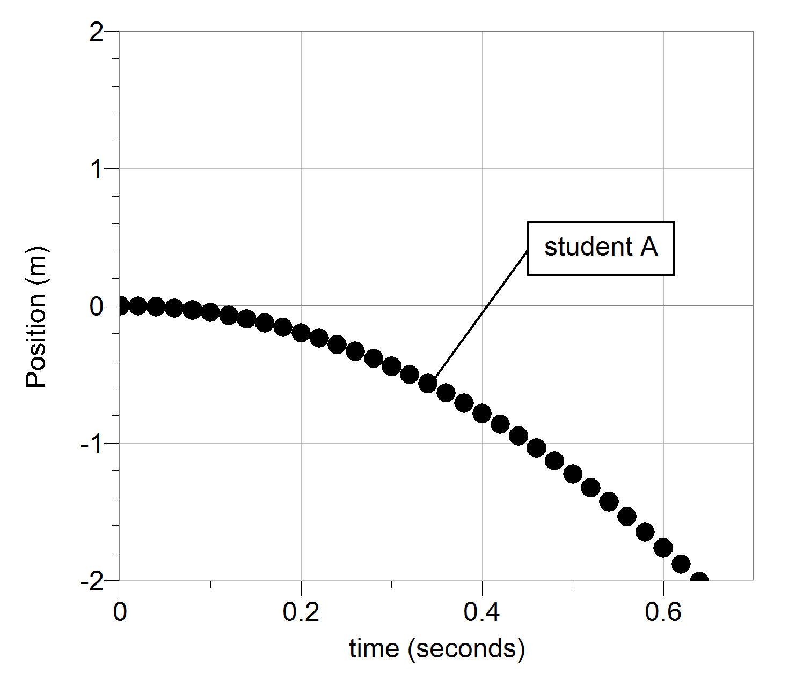
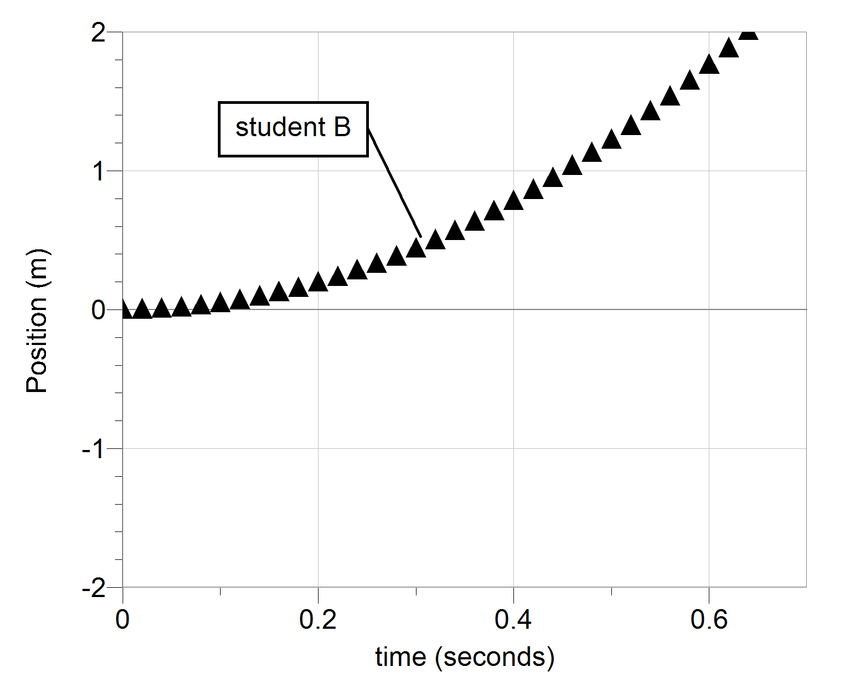
A post-lab question based on “real” lab data
For a ball thrown upward at an initial velocity of 4.5 m/s from a height of 1 meter off the ground the ball with reach a height of about 2 meters off of the ground. Two students mark the exact same video of the motion of a ball as it is dropped from a height of 2.0 meters. Student A produced the graph labeled "student A". Student B produced the graph labeled "student B". Both graphs are equally valid and accurate. What assumption(s) did each student make when producing their graph?

Slide 30
a. Both student A and B assumed the origin to be at the point of drop and defined the positive direction of motion to be downward. b. Both student A and B assumed the origin to be at the point of drop and defined the positive direction of motion to be upward. c. Both student A and B assumed the origin to be at he ground level and defined the positive direction of motion to be downward. d. Both student A and B assumed the origin to be at the point of drop but student A defined the positive direction of motion to be downward. e. Both student A and B assumed the origin to be at the point of drop but student B defined the positive direction of motion to be downward.

Slide 31
Student comments of the class as a whole
Formal comments online in the course evaluation form were not very good.
Many students told me face to face that they had a great experience in the class.
Some how the negative comments seem to show up in the formal reviews but the positive comments are not written but only spoken to me or the TA. I am not sure of the reason for this. Is this a social media effect?

Slide 32
Comments from a TA that worked two semesters in a row with the course.
“In my second term as a TA, the greatest improvement I noticed was that lab instructions and grading rubrics were made simpler, clearer, and more concise. I noticed that the students stressed less about interpreting assignments and lab questions and were able to provide better answers with less help from me. Complex rubrics can cause a lot of stress for grade-conscientious students.”
“Online quizzes allowed me to interact more with the students, answering questions and explaining concepts instead of spending time grading their assignments during class. I would definitely make this a permanent part of the curriculum.”

Slide 33
Comments from a TA that taught the old lab program and also taught the new program
“First of all the students learning was definitely enhanced. Rather than having equations presented so they could simply plug in numbers from measurements, students actually learned the concepts and then found the corresponding equations which led to them understanding said equation.”
“Much more during spring 2016 than during my previous semesters teaching did I hear students exclaim, ‘Oh, I get it now.’ Also I was asked ‘why do we care about the particular topic we are studying?’ a lot less with the newer course than with the old.”

Slide 34
Where are we now after three semesters?
The “wreckage” from the old curriculum has mostly been removed.
A second instructor has tried the curriculum with success.
Most of our writing errors have been fixed.
We have student data from all of the lab activities showing that they can actually do the activities in the manual. We can now hold them accountable for doing good quality scientific inquiry.

Slide 35
Where to go next?
Better matching the course to the original plan.
Finding better ways to assess student learning.
Improve TA resources such as an instructor version of the lab manual.
Replace some activities that are not as good at teaching physics concepts and laboratory skills.

Slide 36
Special Thanks to:
Our Laboratory Manager, Nathan Power for giving moral support when I wanted to quit and listening to me cry.
Our Shop Manager, Jeremy Petersen for the many emergency fixes we did almost daily.
The student Demonstration Assistants for “covering” for me while I struggled with this task. They also tested many of the new apparatus designs, and listened to me cry.
The physics department faculty for not firing me while the train was “wreaked”.
My wife and sons for supporting me while I was gone (mentally) for 60 hours a week at work. (They are not very good at listening to me cry but they allow it. They would tell me to “buck-up” and get to work.)

